Slide 1
AR Storytelling
History and Introduction
Presented by Steven King

Slide 2
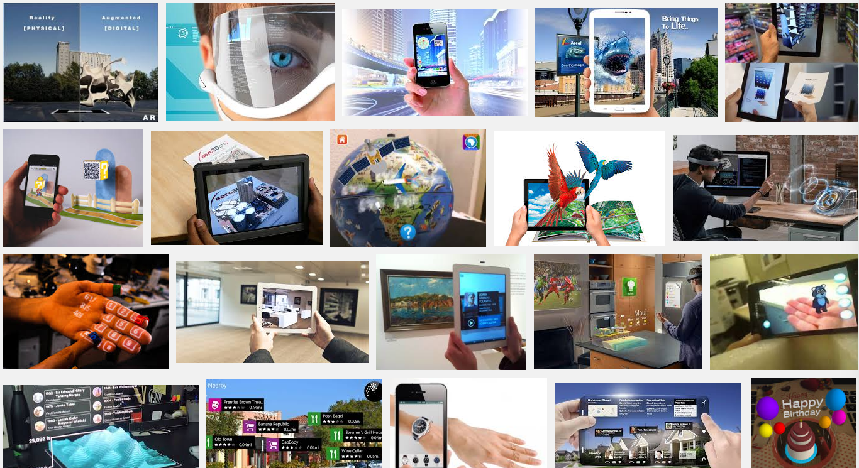

The Future is from the Past
Google Image Search for Augmented Reality

Slide 3
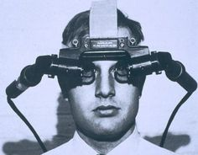
A Brief
History
Quick Overview

Slide 4
Define
“In laymen's terms, augmented reality is defined as computer-generated content—which typically includes graphics, audio and other sensory enhancements—that is superimposed over live images to enhance the real world.”.
The Wall Street Journal

Slide 5
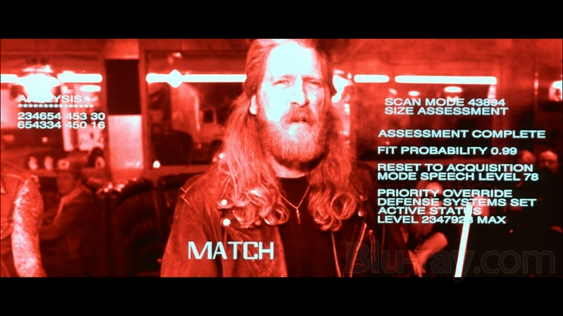
Back to the Future?
Terminator, 1984

Slide 6
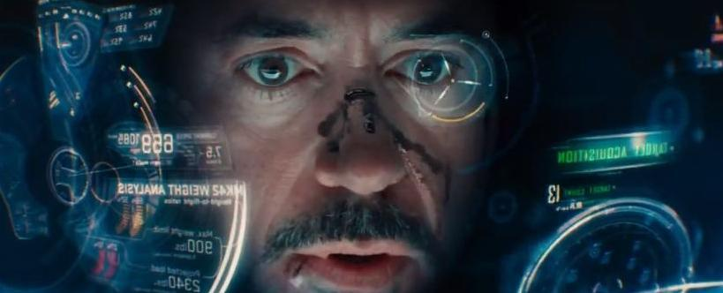
More Movies
Iron Man, 2008
https://www.youtube.com/watch?v=7Nz4c0DqW7k

Slide 7
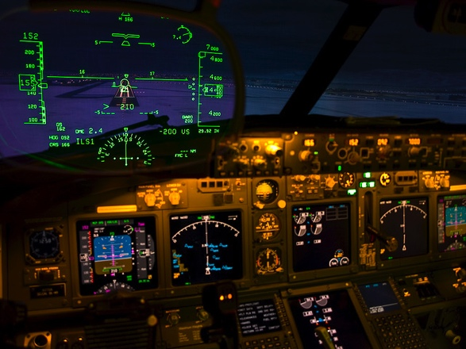
Like the movies
HUD Cockpit 2009

Slide 8
AR History
1990 Boeing Researcher coined phrase
1992 Heads Up Display for Fighter Jets
1999 NASA Starts Using HUD
2004 Research on Cell phones
2008 Washington Post Stadium
2014 Google Glass

Slide 9
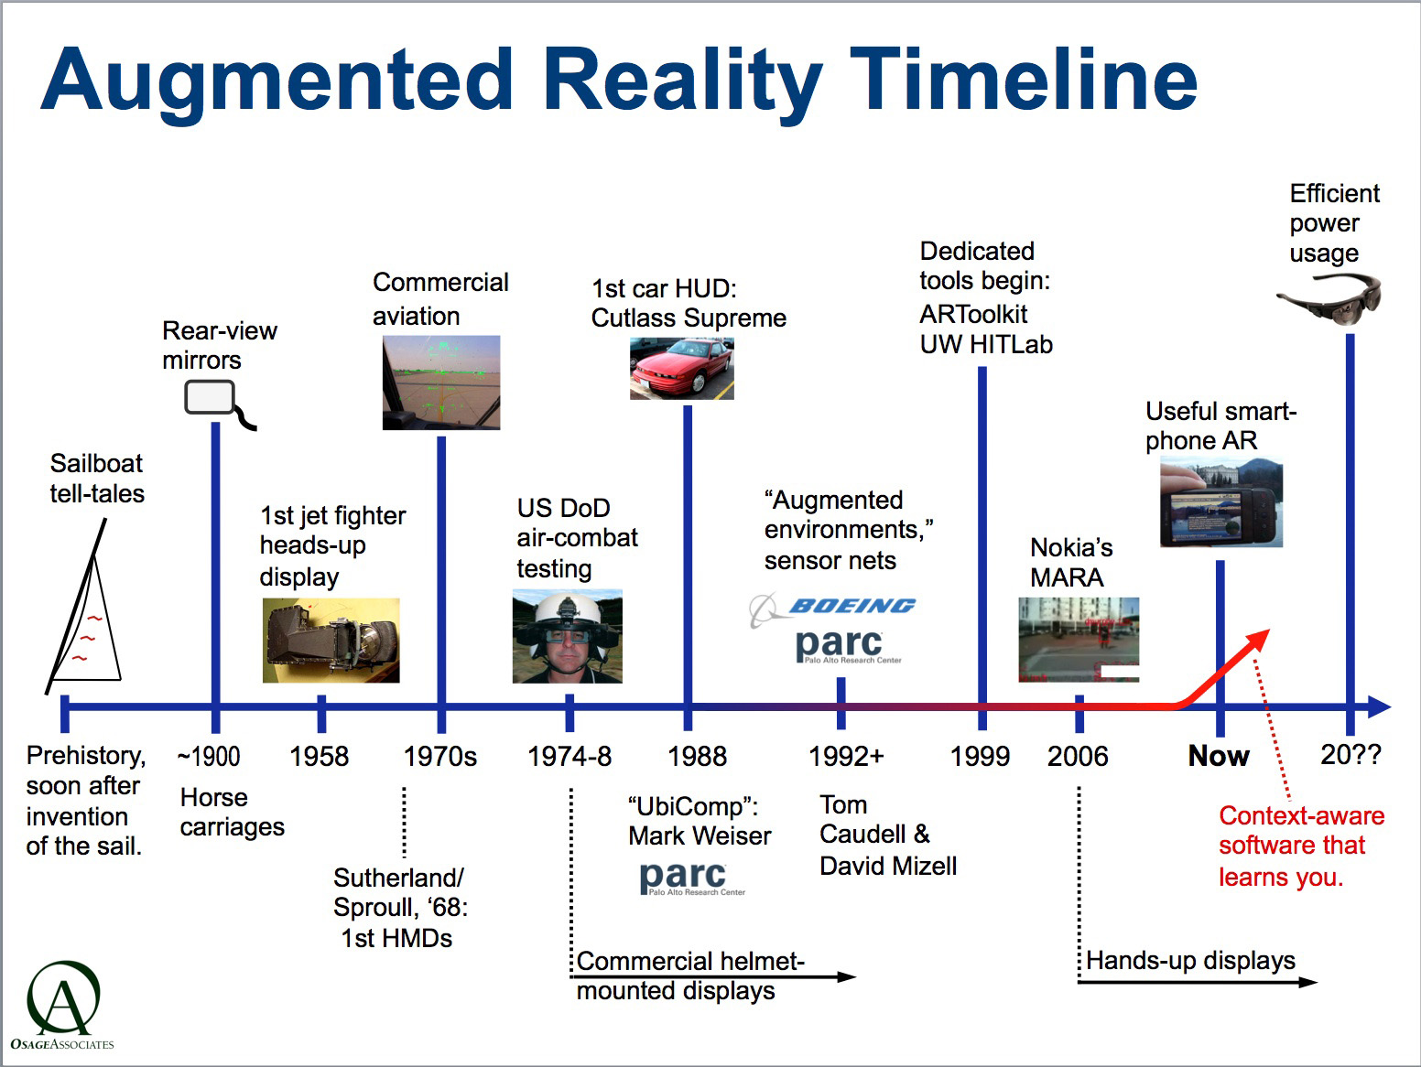
Brief
History
1985

Slide 10
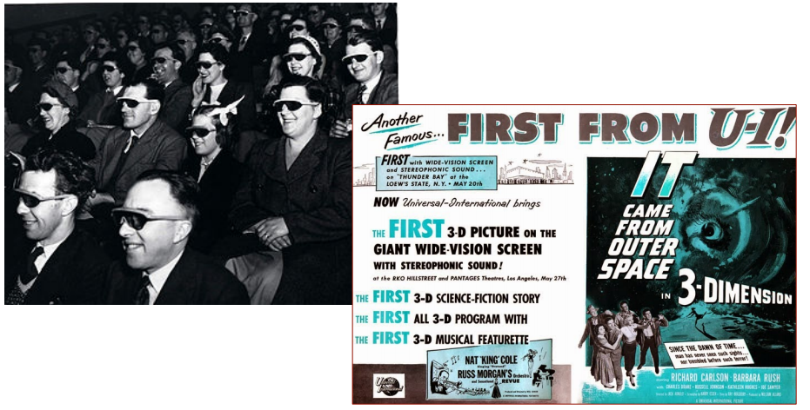
Brief
History
1935

Slide 11
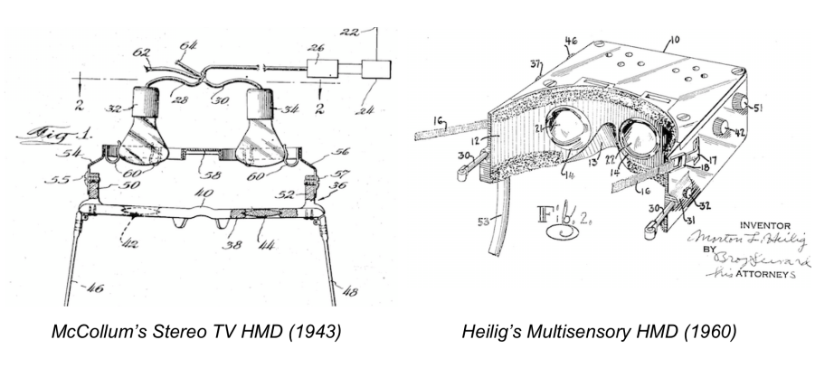
Brief
History
1943, 1960
Patent Applications

Slide 12
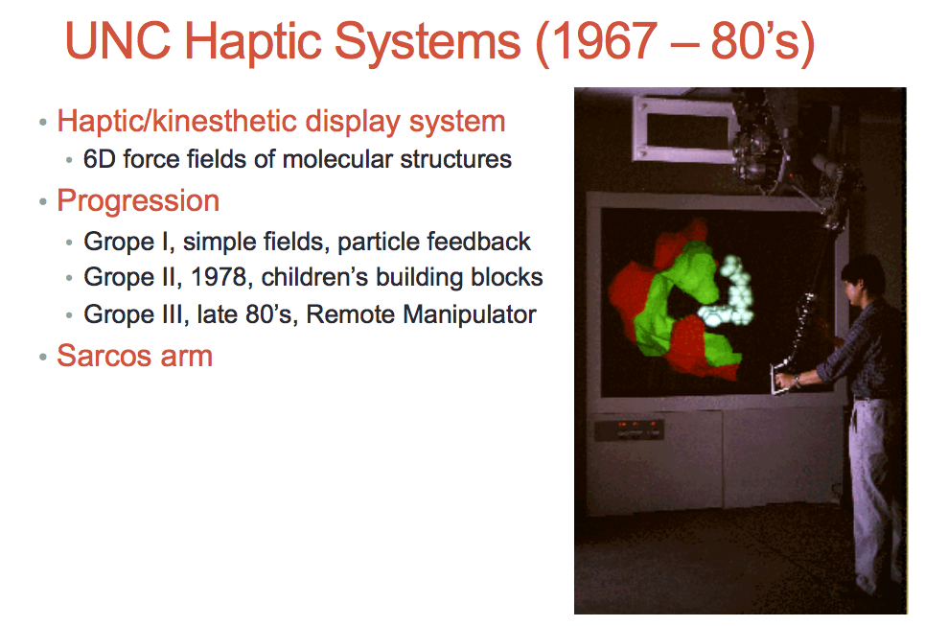
Brief
History
Go Tarheels!
Slide from
Mark Billinghurst
University of Australia

Slide 13
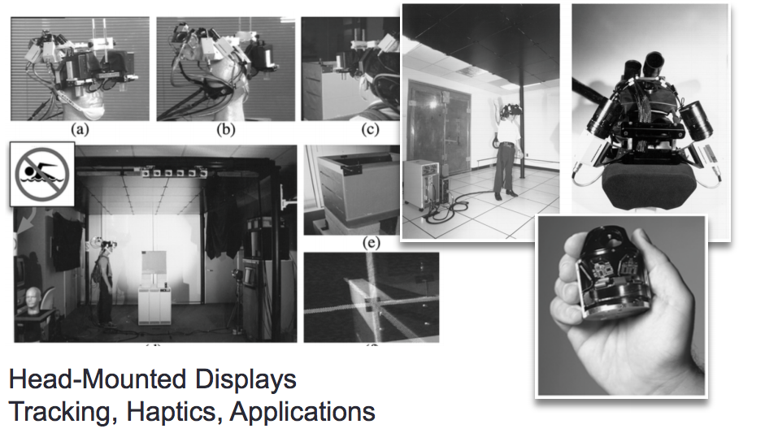
Brief
History
Go Tarheels!
UNC Research Continued in 80-90’s

Slide 14
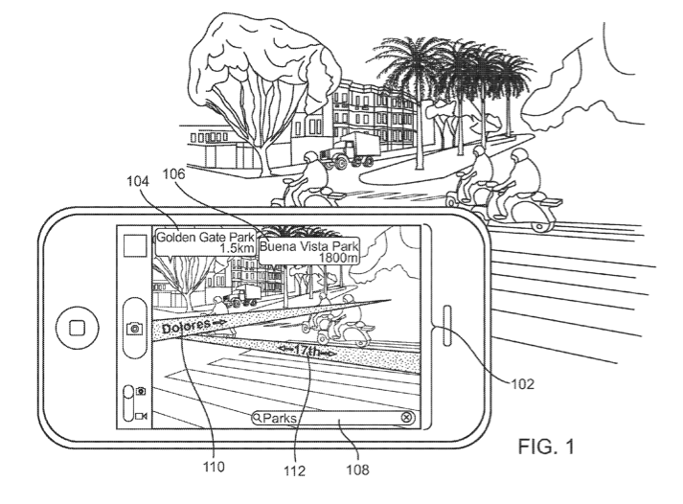
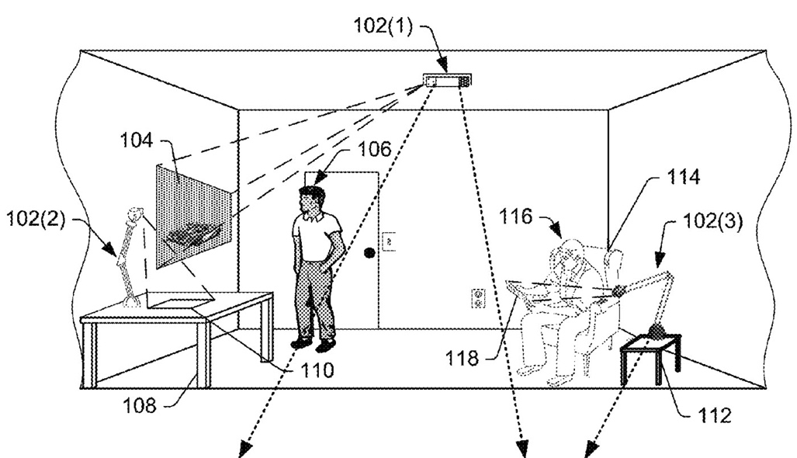
Brief
History

Slide 15

Brief
History
https://www.youtube.com/watch?v=5R1snVxGNVs

Slide 16
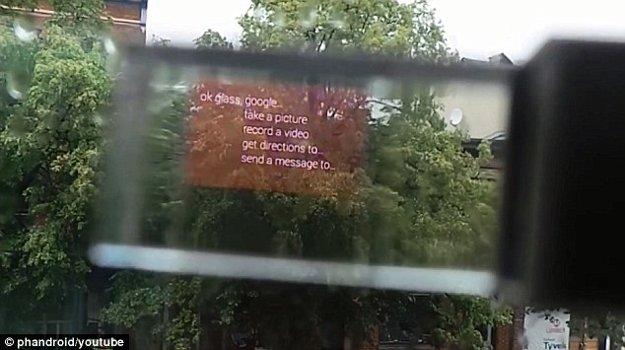
Brief
History
https://www.youtube.com/watch?v=5R1snVxGNVs

Slide 17
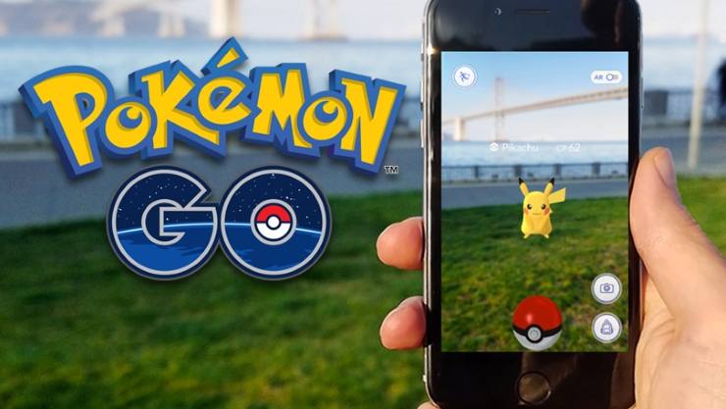
Brief
History
Pokémon
Go
https://www.youtube.com/watch?time_continue=23&v=0gHp8PuXAIk

Slide 18
Brief
History
15 million Daily Users
https://www.youtube.com/watch?time_continue=23&v=0gHp8PuXAIk

Slide 19
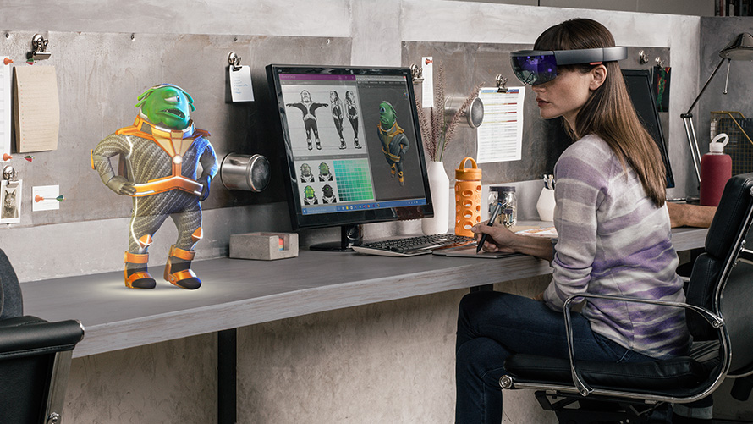
Hololens
https://www.youtube.com/watch?v=29xnzxgCx6I
The computer-generated simulation of a three-dimensional image or environment that can be interacted with in a seemingly real or physical way by a person using special electronic equipment, such as a helmet with a screen inside or gloves fitted with sensors.

Slide 20
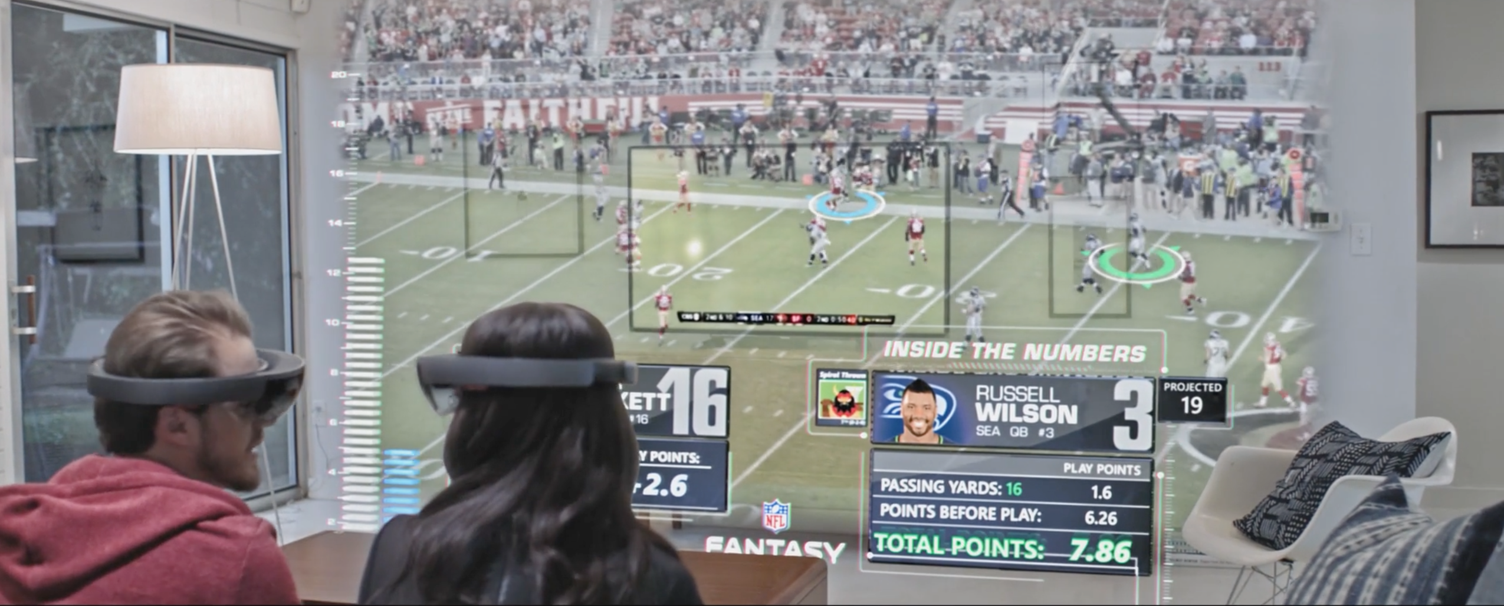
Hololens
https://www.youtube.com/watch?v=29xnzxgCx6I
The computer-generated simulation of a three-dimensional image or environment that can be interacted with in a seemingly real or physical way by a person using special electronic equipment, such as a helmet with a screen inside or gloves fitted with sensors.

Slide 21
Major Characteristics of Augmented Reality
Graphical Display
View of Real World

Slide 22
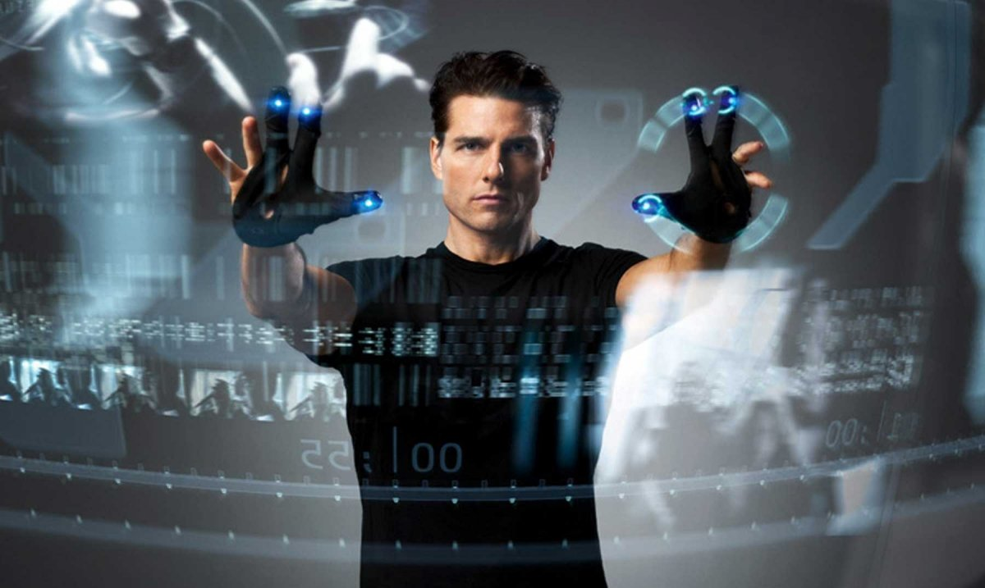
Gesture and Voice
Interfaces

Slide 23
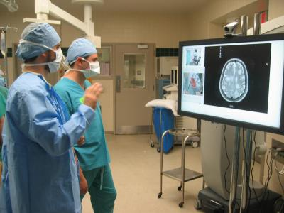
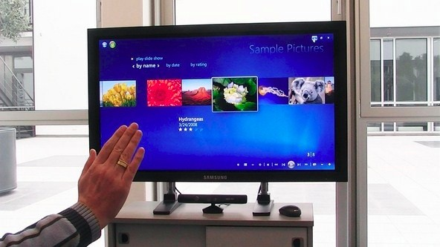
Leap Motion
X Box Connect
Others

Slide 24
Leap Motion
X Box Connect
Others

Slide 25

Leap Motion
X Box Connect
Others

Slide 26
AR vs VR
Who can explain the difference?

Slide 27
Assignment
Putting into practice

